Slide 1
MassMutual Strategic Distributors-DI
FOR FINANCIAL PROFESSIONALS. NOT FOR USE WITH THE PUBLIC.

Slide 2
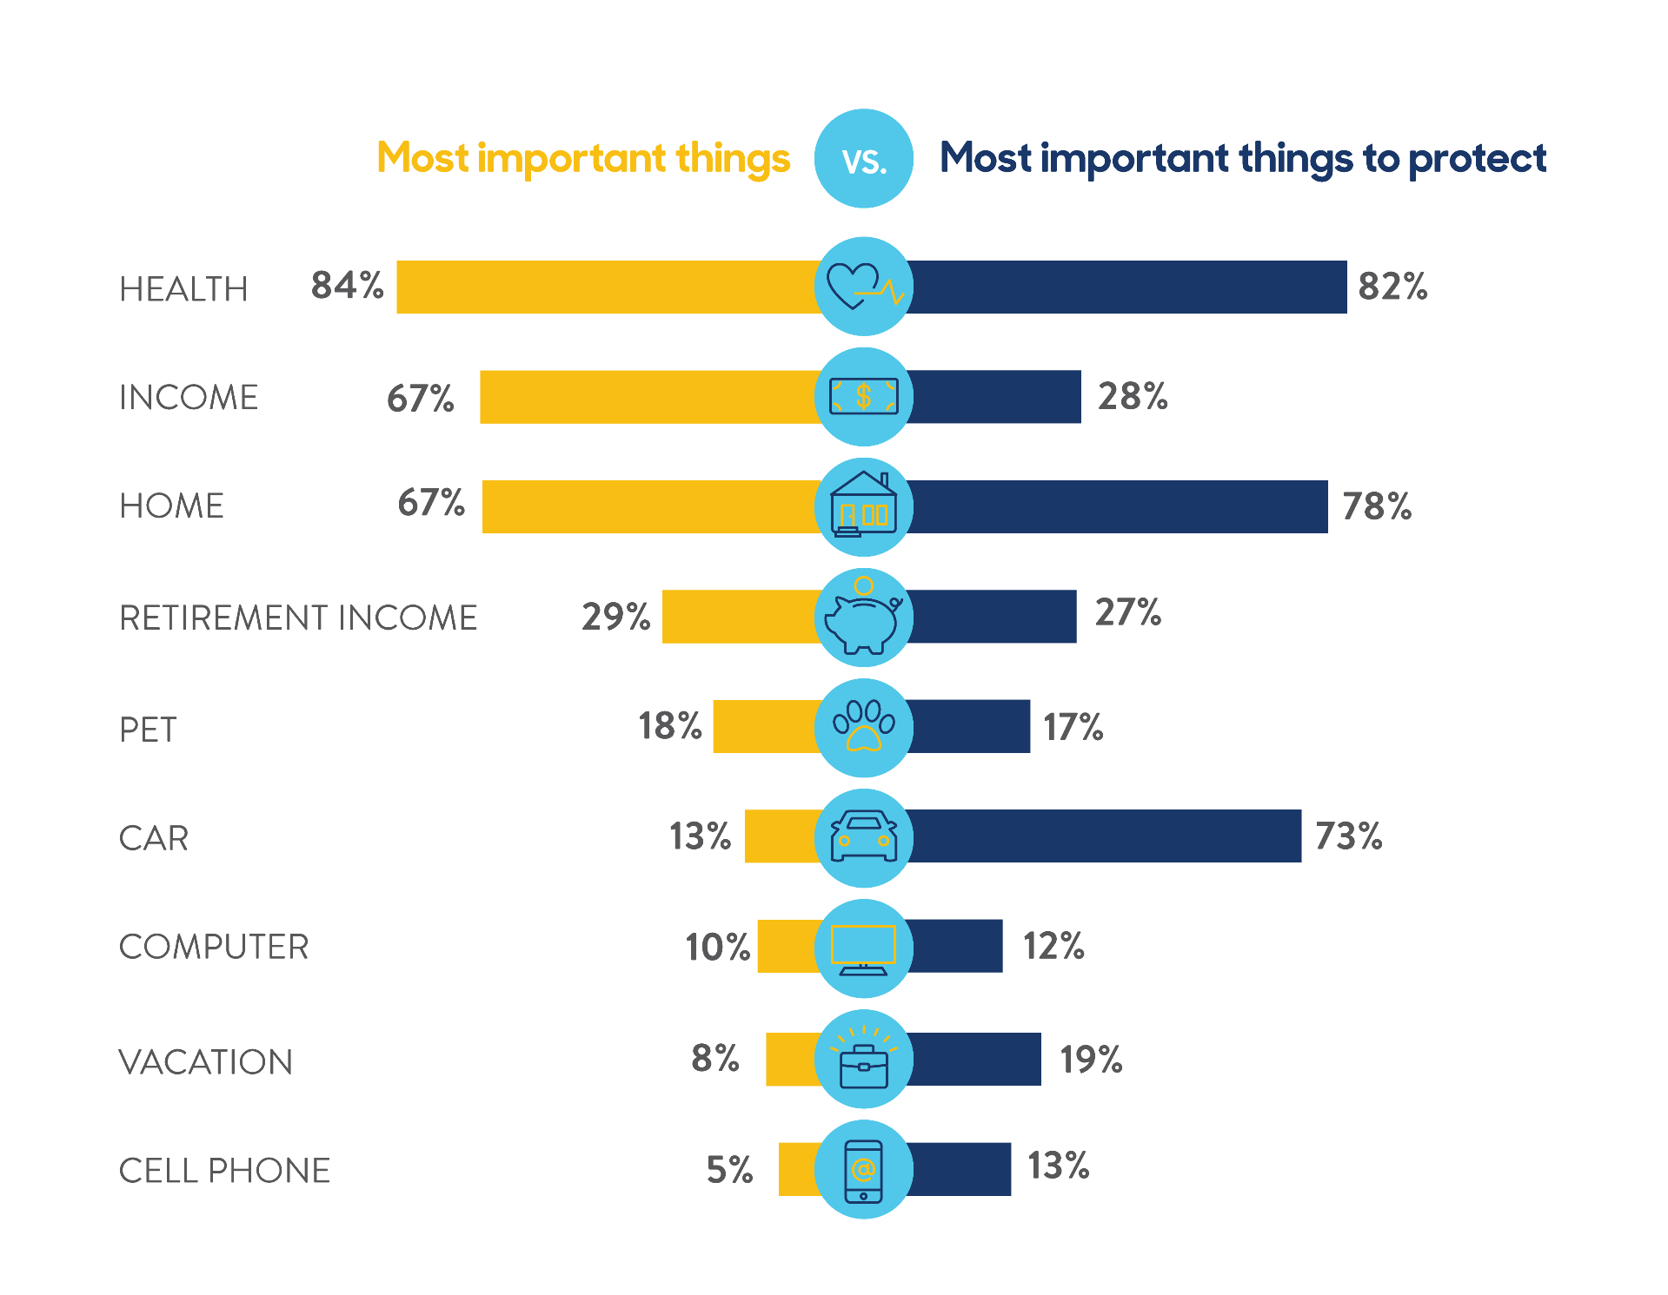
America is underinsured
Insuring your income
From a list of items commonly seen as important to people, survey respondents in 2014 identified their THREE…
HEALTH . INCOME . HOME
CDA 2014 Consumer Disability Awareness Study (most recent data available)
Notes:
CRN202102-224475 Slide 3
Read Slide. Sources
1. 2016 LIMRA Ownership Study
2. CDA 2014 Consumer Disability Awareness Study

Slide 3
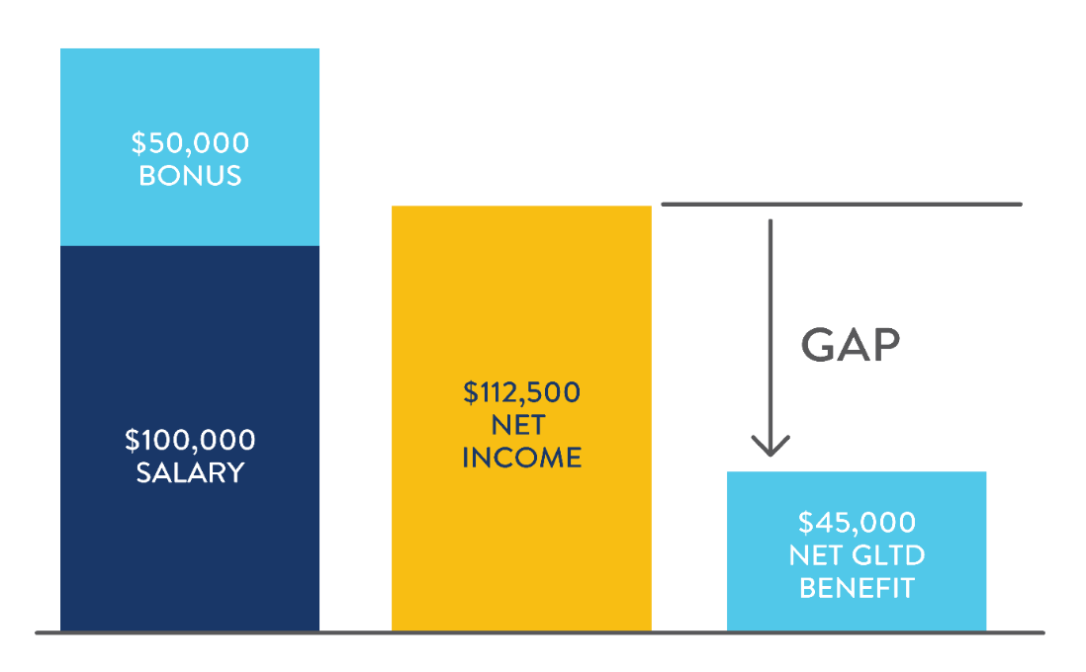
Human Life Value and the DI Gap
The DI GAP
The DI Gap is the difference between current net income and the disability benefits clients would receive if they became disabled.
Typical group LTD plans
cover about
60% of base salary
The above example assumes an effective tax of 25% and a group LTD plan paid for by the employer that covers 60% of base salary up to $5,000 per month.
Notes:
CRN202102-224475 Slide 14
See speakers notes from previous slide

Slide 4
It won’t happen to me…
Do they know the odds?
¹ IRS, 2017 Internal Revenue Service Data Book.
² Javelin’s 2018 Identity Fraud Report. February 6, 2018.
³ AAA Foundation for Traffic Safety. 2017 Traffic Safety Culture Index.
⁴ Social Security Administration, Fact Sheet, January 2019.
Notes:
The first and maybe most prominent objection is – It won’t happen to me. It is your job to help them understand the realities of a disability.
One of the reasons they may not think it will happen to them is because they dramatically underestimate their odds of experiencing a sickness or injury that would interrupt their ability to earn an income.
This slide shows the odds of becoming disabled may be as great a risk as several other types of things they typically insure against, like a house fire, car accident and hospitalization.
There is a consumer approved flyer, “Do You Know The Odds”, that you can share with clients (DI95032).

Slide 5
Perspectives on disability
Reality: Accidents/Injuries
=
88%
of all disabilities =
something other than
accident/injury
only12%
of disability claims
Integrated Benefits Institute, Health and Productivity Benchmarking, 2017 Long Term Disability, September 11, 2018
Notes:
CRN202102-224475 Slide 7
Read slide

Slide 6
Why MassMutual’s Radius Choice?
INDIVIDUALLY
OWNED
DIVIDEND-ELIGIBLE¹
FULLY PORTABLE
NON-CANCELLABLE TO AGE 65 ²
CUSTOMIZABLE
STRONG DEFINITION OF TOTAL DISABILITY
EXTENDED PARTIAL DISABILITY BENEFITS RIDER
CAN SUPPLEMENT GROUP LONG TERM DISABILITY COVERAGE ALREADY IN PLACE ³
BONUSES AND INCENTIVE INCOME CAN BE INCLUDED IN COVERED EARNINGS
1 Dividends are not guaranteed.
2 Provided premiums are paid on time.
3 This individual disability income insurance does not coordinate with your group long term disability coverage. Claim decisions are rendered independent of each other.
FOR FINANCIAL PROFESSIONALS. NOT FOR USE WITH THE PUBLIC.
6
Notes:
There are already many reasons that Radius Choice may be the right choice for your clients.
Examples of how Radius Choice can be customized include, but are not limited to, RetireGuard, Student Loan Rider, Own Occ Rider, Future Insurability Option Rider, and Benefit Increase Rider.

Slide 7
Executive Disability Income Insurance
MassMutual®’s Worksite Executive Disability Income Insurance product is available to meet the needs of the marketplace with underwriting enhancements that increase benefits for employer or employee paid coverage.
Class Eligibility — the eligible class must be objective and clearly defined. The employer cannot
pick who they want to cover.
Plan Options are available with a wide array of riders.
FOR FINANCIAL PROFESSIONALS. NOT FOR USE WITH THE PUBLIC.
7

Slide 8
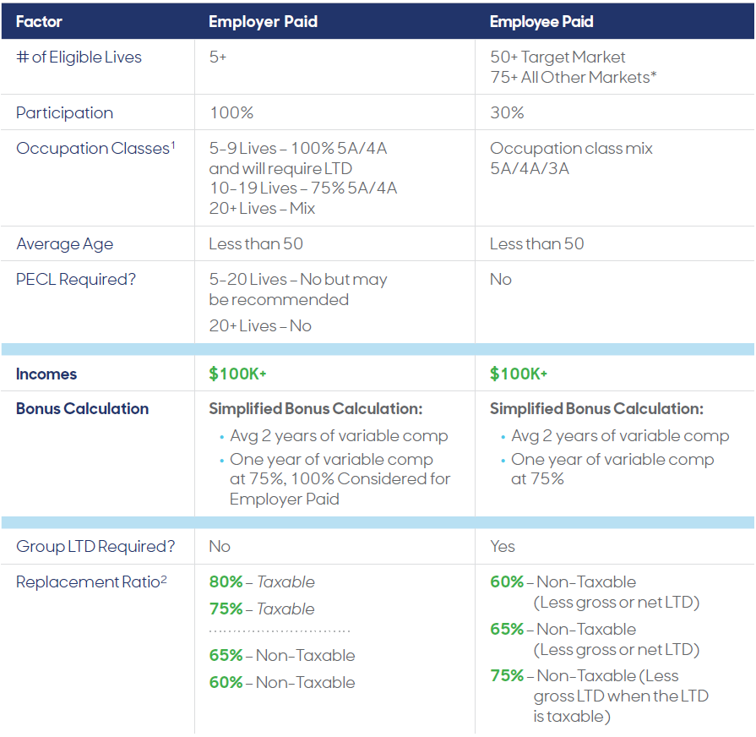
Executive Disability Income Insurance
* Although we can have a mix of occupations for employer paid cases with 20 or more lives, having a higher concentration of lower occupation classes may drive the group to have a lower GSI offer. For employee paid cases with 75+ lives, we can include 5P, 4P and 3P occupation classes, but groups must have < 35% census exposure on 3P Occupation Classification.
1 Although we can have a mix of occupations for employer paid cases with 20 or more lives, having a higher concentration of lower occupation classes may drive the group to have a lower GSI offer.
2 The Plan design Replacement Ratios listed above are our standard options. Other replacement ratios can be considered and would be evaluated on a case-by-case basis.
FOR FINANCIAL PROFESSIONALS. NOT FOR USE WITH THE PUBLIC.
8

Slide 9
DI Underwriting is now easier than ever…
Around 62% of policies applied for are eligible for the Express DI Underwriting program!
Through our Express DI Underwriting program, applicants who meet certain criteria are eligible to apply for fully underwritten individual DI and/or BOE coverage with fewer requirements.¹
 | RADIUS CHOICE | BUSINESS OVERHEAD EXPENSE (BOE)
ISSUE AGE | Up to age 50 | Up to age 50
ANNUAL INCOME | At Least $30,000² | At Least $30,000²
OCCUPATION CLASS | 3A and above | 3A and above
STATE AVAILABILITY | All states with exception of Puerto Rico | All states with exception of Puerto Rico
MAXIMUM MONTHLY BENEFIT | $10,000³ | $10,000⁴
WAITING/ELIMINATION PERIOD | 90 days and above | All
BENEFIT PERIOD | All | All
AVAILABLE RIDERS | All⁵ | All
APPLICATIONS | Fully completed A2000 application and • Up to $6,000 — CMI or Tele-CMI⁶ • $6,001 – $10,000 — Tele-CMI⁶ | Fully completed A2000 application, CMI⁶, and BOE Supplement
FINANCIAL REQUIREMENTS | • Up to $6,000 — No financial requirements needed • $6,001 – $10,000 — Published financial requirements | No financial requirements needed
MassMutual reserves the right to discontinue the underwriting program at any time.
1 MassMutual reserves the right to order additional requirements based on cause. This may include a Personal History Interview, Supplementary Health Statement and/or Attending Physician Statement. We also reserve the right to rate, modify, exclude or decline coverage based on our findings.
2 Starting Professionals will be based on Starting Professional Limits by specialty not to exceed the Maximum Monthly Benefit.
3 Includes inforce and applied for coverage (excluding Group LTD) with any carrier and MassMutual. Must qualify based on our published financial underwriting rules.
4 Includes inforce and applied for coverage with any carrier and MassMutual. Must qualify based on our published financial underwriting rules.
5 If applying for the Benefit Increase Rider, client must purchase 75% of the maximum eligible benefit amount for the Base policy to qualify for this Rider.
6 When in combination with a Life sale, we will hold for Life’s published age amount requirements for our review.
FOR FINANCIAL PROFESSIONALS. NOT FOR USE WITH THE PUBLIC.
9
Notes:
Review slide.
The Temporary Express DI Program is being extended due to COVID-19 until the end of 1st quarter 2021.

Slide 10
DI Underwriting is now easier than ever
Starting Professional Program
Certain applicants in their final stages of training, or in their first two years of professional practice, may be eligible for special issue limits based on anticipated income…
Architect
Attorney
Computer Science, Engineer
CPA
CRNA
Dentist
Doctor (M.D., D.O.)
Engineer
Nurse Practitioner
Optometrist
Pharmacist
Physician Assistant
Physical Therapist (DPT)
Psychologist (Ph.D.)
Scientist (Master’s Degree or Ph.D.)
Senior MBA
Veterinarian
See DI75003 for more information
FOR FINANCIAL PROFESSIONALS. NOT FOR USE WITH THE PUBLIC.
10
Notes:
Review slide.

Slide 11
^{Key Demographics/ Industries:}
Medical
Residents
Dental Residents
Young
Professionals
Business Owners
Riders to consider as selling points when talking to clients:
- Student Loan Rider
- Benefit Increase Rider or FIO
- RetireGuard
FOR FINANCIAL PROFESSIONALS. NOT FOR USE WITH THE PUBLIC.
11
Notes:
CRN202201-258044 Slide 20
Please Note: There is an additional cost for most riders.
It is important to note that the listed riders’ benefits and/or provisions are only summaries.
Refer to the DI Reference Guide and specimen policy for detailed information about these riders.
Automatic Benefit Increase Rider (ABI) The Automatic Benefit Increase Rider allows the automatic annual purchase of benefits without evidence of medical or financial insurability - the insured must be Actively At Work and cannot be disabled. The increase amount is 3%. This rider can be attached to the policy at no additional cost, and the policyowner must apply to renew the rider every five years to keep it in force
Benefit Increase Rider (BIR) & Future Insurability Rider (FIO)
The Benefit Increase Rider (BIR) allows the purchase of additional monthly disability coverage once every three years as the insured's income increases. The insured must:
Financially qualify.
Be actively at work.
Not be disabled.
3. The Future Insurability Option Rider
The Future Insurability Option Rider allows the insured to increase the amount of monthly disability coverage prior to a disability. At issue, the FIO creates a pool of benefits which will be available during annual option periods to increase coverage. Financial underwriting is required and the insured must be Actively At Work and cannot be disabled.
4. Student Loan Rider (SLR)
The Student Loan Rider provides a monthly benefit that will help to reimburse payment of the insured's monthly student loan debt due while the insured is Totally Disabled.
5. Extended Partial Disability Benefit Rider (EPR)
The Extended Partial Disability Benefit Rider provides industry leading protection for periods of Partial Disability. During the first 6 months of disability, the insured may qualify as partially disabled if due to sickness or injury, he/she suffers a minimum 15% loss of time from work or can do some but not all of the main duties of his/her occupation.
After the first six months, the rider provides a benefit for those who suffer a minimum 15% loss of income resulting from a reduced capacity to perform their occupation due to sickness or injury.

Slide 12
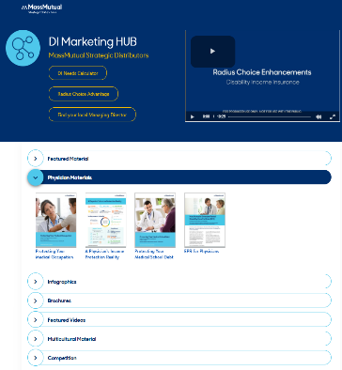
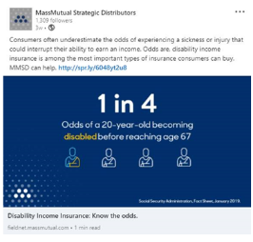
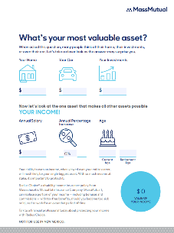
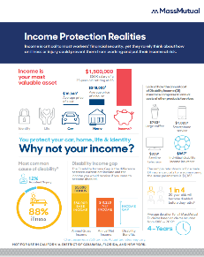
Marketing Support
Microsites
LinkedIn Social Media Posts
DI Marketing Hub
Radius Choice Advantage
DI Commercial
Marketing Flyers & Guides
FOR FINANCIAL PROFESSIONALS. NOT FOR USE WITH THE PUBLIC.
12

Slide 13
Radius Choice (policy form XLIS-RC-15 et al., XLIS-RC-16(FL) and ICC15-XLIS-RC in certain states including North Carolina) is issued by Massachusetts Mutual Life Insurance Company, Springfield, MA 01111-0001.
Executive Disability Income Insurance (MaxElect policy forms XLS-ME-04, XLS-ME-13 et al., ICC13XLSME in certain states including North Carolina, and Radius policy form XL-GS-92 in California) is individual disability income insurance issued by Massachusetts Mutual Life Insurance Company, Springfield, MA 01111-0001. Policies have exclusions and limitations.
2022
SDP8011DI
MM202504-301291

