Slide 1
Case Study Insights: Mastering LTC Funding
Michael Sato

Slide 2
Agenda
Client scenario
Client health condition
Client’s financial situation
Client’s views/values
Recommended plan
Questions?

Slide 3
Case Study 1-James, aged 58 and Joan, aged 57
Lifelong Hawaii residents-may move to Las Vegas after retired
James has own plumbing business
Joan is a stay-at-home Mom
Both in good health
2 daughters, one aged 22 and one aged 17

Slide 4
Case Study 1-Financial circumstances
Current monthly income: $10,000
Net worth: $5 million
Hope to leave legacy to two daughters

Slide 5
Case Study 1-James and Joan’s LTC experience
James’ father suffered fall and broke ankle (bad experience with rehab facility after surgery)
Joan’s widowed mother is starting to slow down with age (needs help with grocery shopping and cleaning the house)
James’ father and mother and Joan’s mother do not have any cognitive issues

Slide 6
Case Study 1-James and Joan’s thoughts on LTC insurance
Not a fan of one-pays
Inflation is important
Unlimited benefits are important
Cash indemnity benefits are not important

Slide 9
Case Study 1-Recommendation One America Asset Care Recurring Premium WL
$12,000 month benefit for each
Unlimited benefit amount
$300,000 death benefit
Annual premium-$16,059, pay to age 95
Reasons:
Provides unlimited benefit
All or remaining death benefit passes to daughters

Slide 10
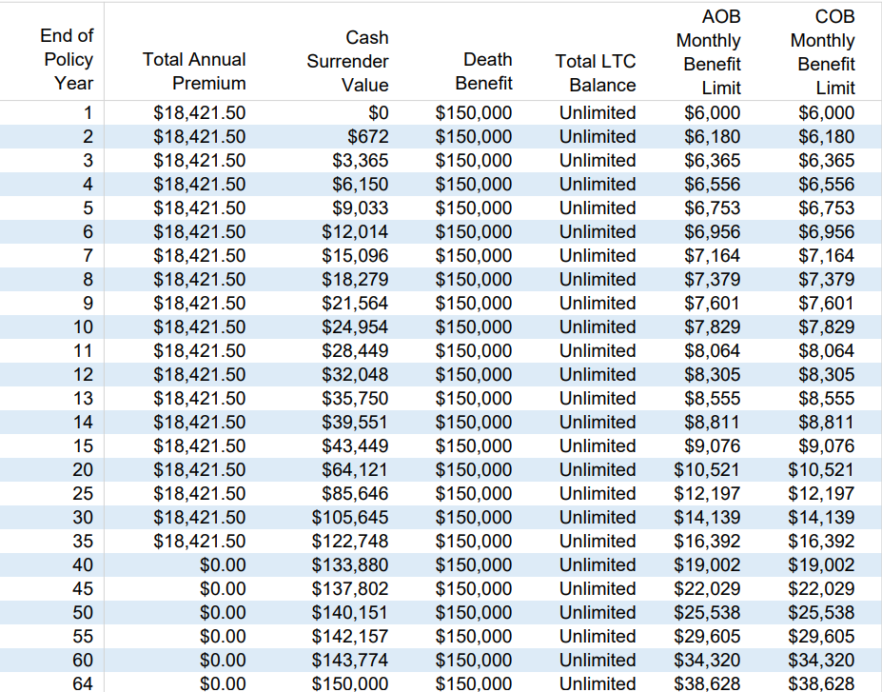
Case Study 1-Considerations (Inflation)

Slide 11
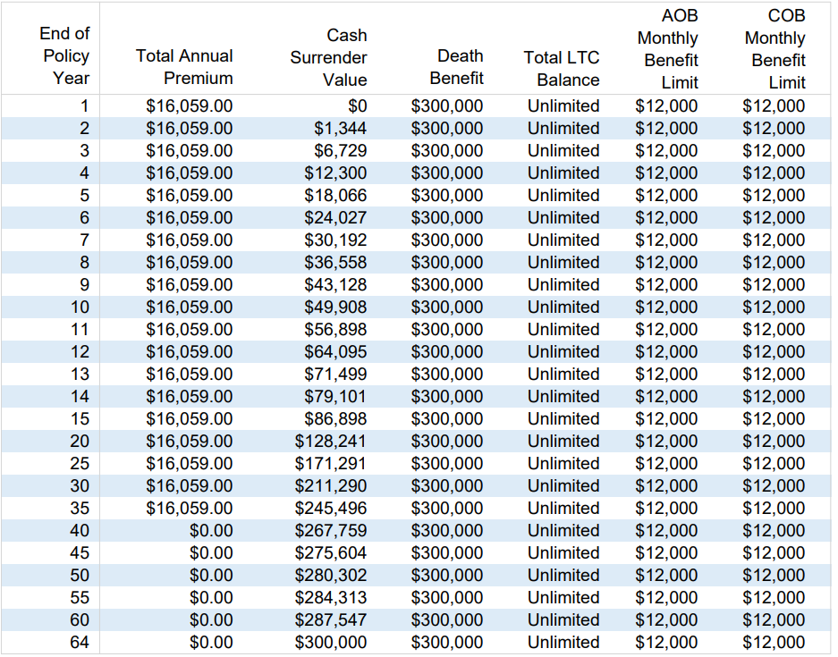
Case Study 1-Considerations (No-inflation)

Slide 12
Case Study 1-Other considerations
James is a sole proprietor so he can deduct a portion of his premium as an unreimbursed medical expense
Annual life premium: $6,528
Annual LTC premium: $9,531
Total Annual Premium: $16,059

Slide 13
Case Study 2-George, aged 50 and Harumi, aged 40
George is an only child and was born and raised in Hawaii
Harumi is a green card permanent US resident since marrying George 10 years ago
George is an electrical engineer and Harumi works for a travel agency
Both in good health
They have no children

Slide 14
Case Study 2-Financial circumstances
George earns $9,000/month
Harumi earns $3,000/month
They have a net worth of $1,500,000
They own a condo worth $800,000 but still pay a $2,200/month mortgage with 20 years remaining
George has a $1,000,000 20-year term policy and Harumi has a $200,000 20-year policy they purchased after getting married

Slide 15
Case Study 2-George and Mayumi’s LTC experience
George’s father died in the hospital from a stroke 10 years ago
George’s mother is 80 years old but still active volunteering at her church
George has never given care to anyone
Mayumi’s grandmother lived with her family until she passed away in her 80s from lung cancer
Mayumi’s family supported her grandmother as she grew more frail with age

Slide 16
Case Study 2-George and Mayumi’s thoughts on LTC insurance
George doesn’t think that LTCI is needed because it will never happen to him
Mayumi has helped care for her grandmother, so she knows how difficult it is to care for the elderly
Mayumi worries about caring for George when he is old with no family to depend on
Mayumi worries about the financial cost of LTC should the caregiving last years

Slide 17
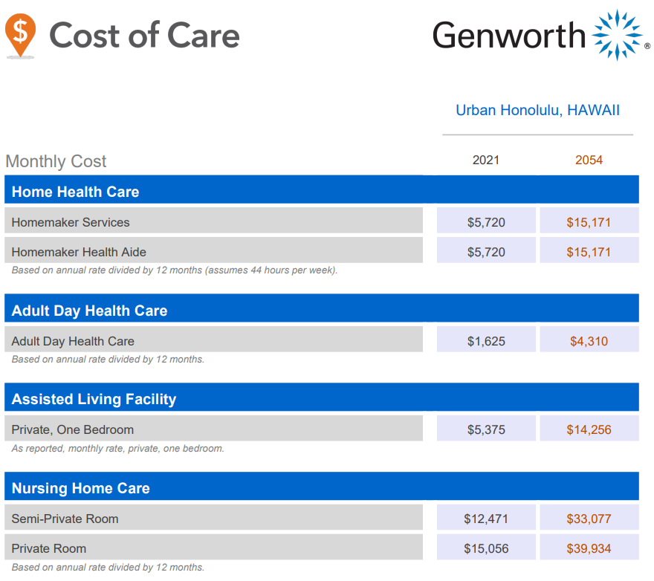

Slide 18
Case Study 1-Recommendation considerations
Make room for compromise between spouses
Get them involved in the process

Slide 19
Case Study 2-Recommendation-George Nationwide No-Lapse Guarantee UL II with LTC rider
$750,000 death benefit
$20,000 month indemnity benefit for 25 months
$500,000 pool of money
Monthly premium-$13,090, 15-pay
Reasons:
Provides death benefit protection (pays off mortgage/income protection)
Policy paid up at retirement (age 65)
Guaranteed to age 105
LTC rider costs $194 out of the $1,390/month premium
Tax free indemnity benefit up to $410/day (2024)
True 7702B LTC rider
10% residual death benefit

Slide 20
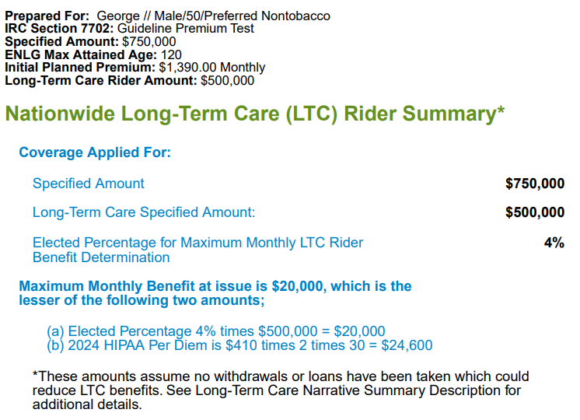
Case Study 2-Considerations

Slide 21
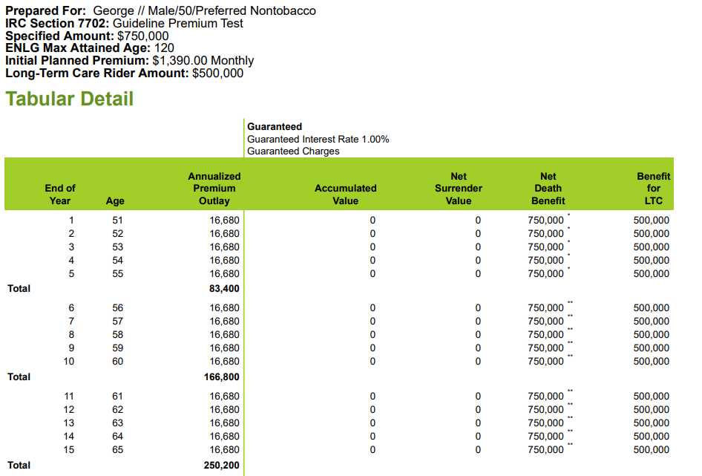
Case Study 2-Considerations

Slide 22
Case Study 2-Recommendation-Mayumi Securian SecureCare III
Single premium-$100,000
$8,161.04/month LTC benefit and $633,467.40 pool of money from day 1
$30,861.76/month LTC benefit and $2,395,518.36 pool of money at age 85
$195,865 death benefit
Guaranteed surrender value of $140,391 at age 80
Reasons:
Provides sufficient indemnity benefit for majority of LTC cases
Provides death benefit to husband if she predeceases him
She can surrender policy should she decide to move back to Japan after husband passes

Slide 23
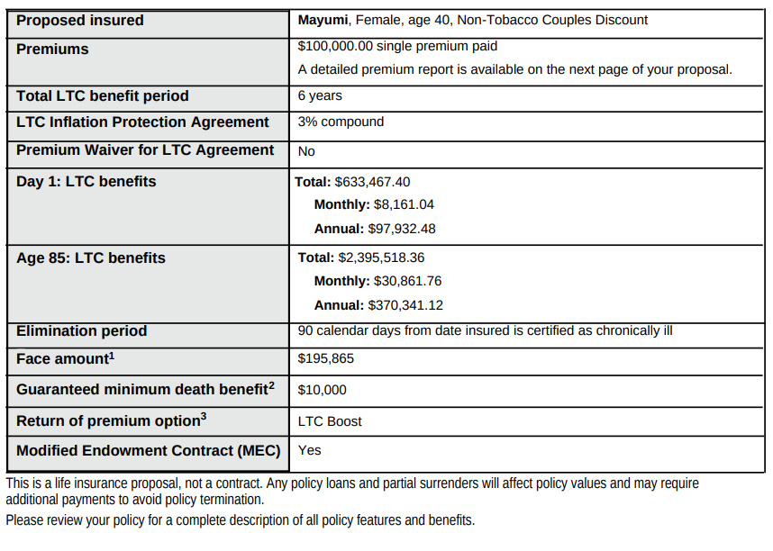
Case Study 2-Considerations

Slide 24
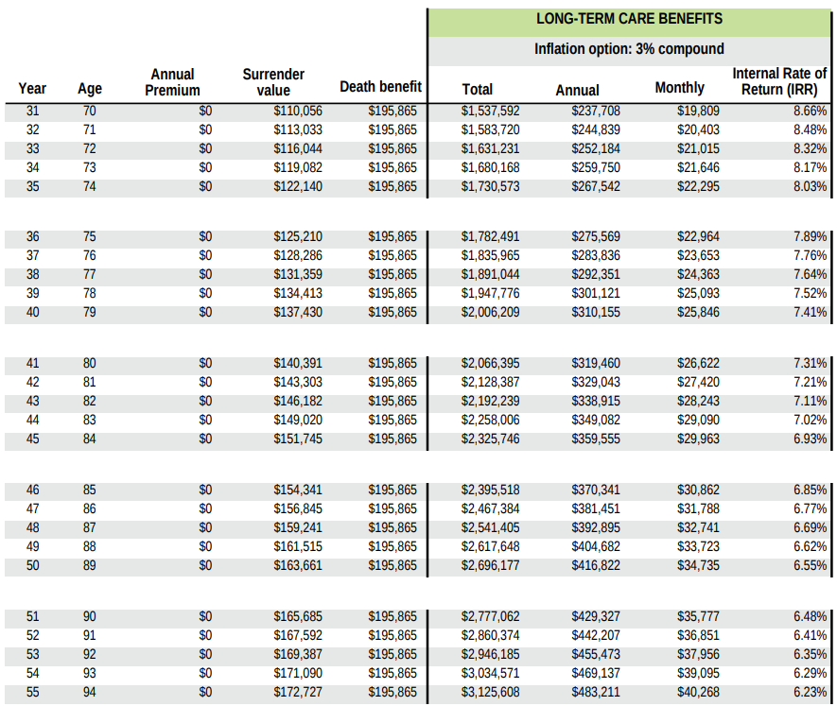
Case Study 2-Considerations

Slide 25
Any Questions?

Slide 26
Thank you!
Michael Sato
msato@askoxy.com
(808) 527-8869

